Slide 1



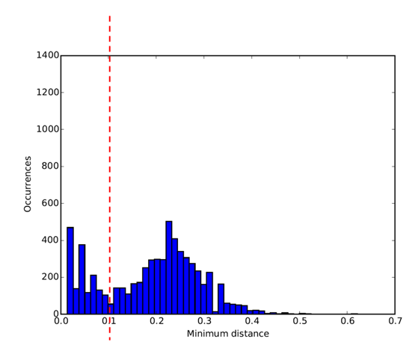
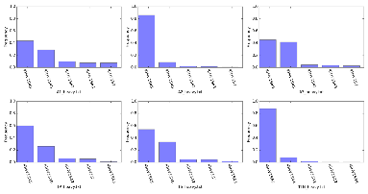
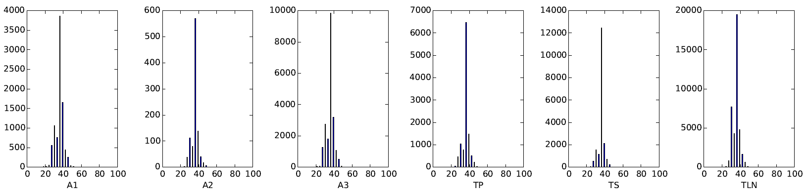




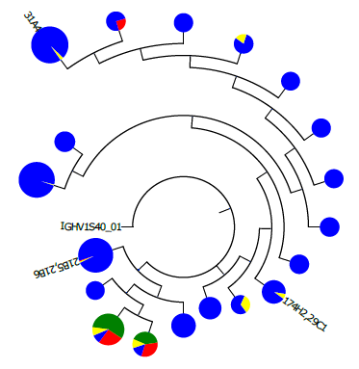
1
FASTQ files for each run
Heavy and kappa chain FASTA files for each run
IMGT rabbit germline library
IgBLASTPlus
sed
mAb sequences
Consolidated IMGT-style analysis files
ExtractFromIMGT
2
3
PlotGermline
4
SpectraType
NeighbourDist
ClusterSeqs
ClusterExtract
ClusterGraph
ExtractFromIMGT
FASTASample

